Slide 1
The Data Mining Tasks

Slide 2
Our Tasks
In order to help the bakery refine their sales and production strategies, we tasked ourselves to do the following:
Datamine temporal transaction information to analyze the traffic flow to the bakery to find their busiest Months, Days, and Hours.
Datamine the best-selling items and when they sell to maximize workplace efficiency and customer satisfaction.
Datamine items that are frequently bought together to maximize business profit.

Slide 3
Datamining Temporal Information
The Question we wanted to answer:
What month/day/hour does the bakery get the most traffic?
Key Challenges:
Recognizing and correctly identifying trends.

Slide 4
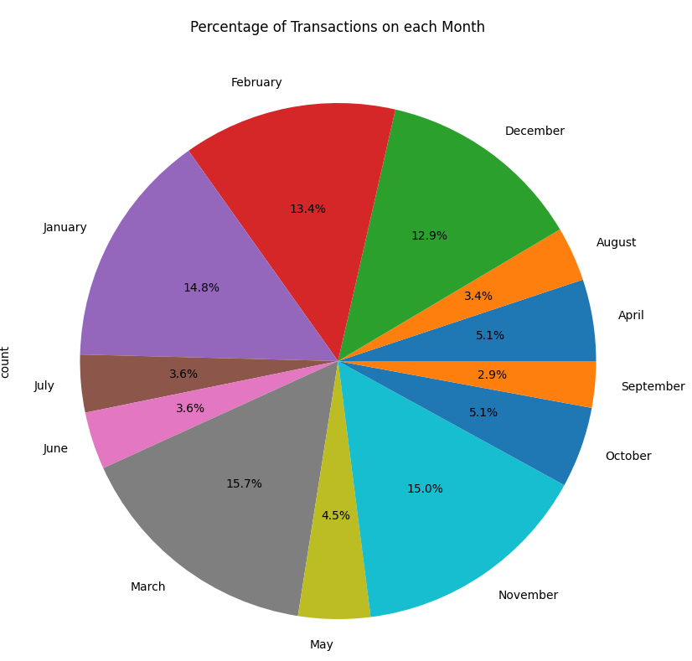
Data Mining Monthly Transactions
We want to find which months are the busiest and which are not.
This data can help with shift scheduling and item stock acquisition to prepare for busier months

Slide 5
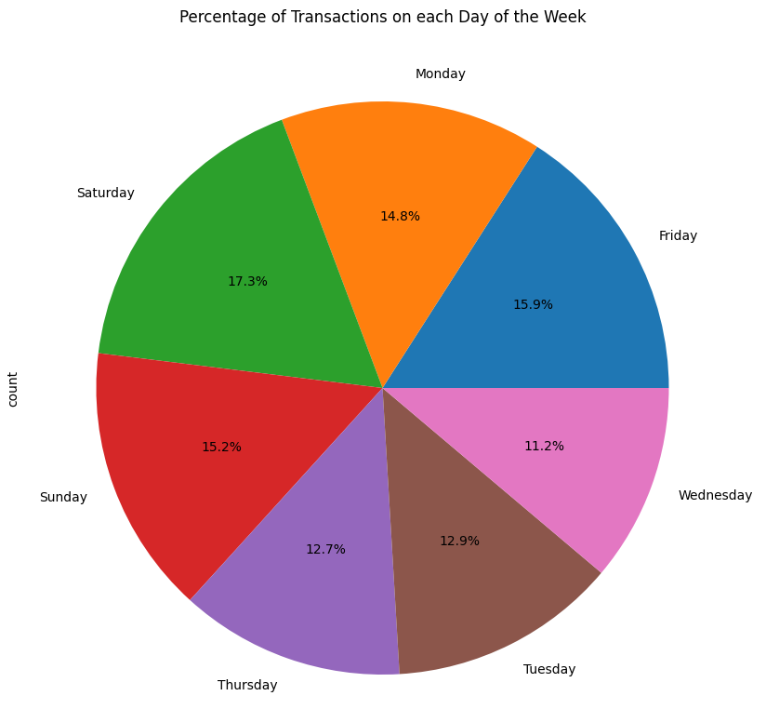
Data Mining Daily Transactions
We want to find which days are the busiest and which are not.
Once again, this data can help with shift scheduling and item stock acquisition to prepare for busier days.

Slide 6
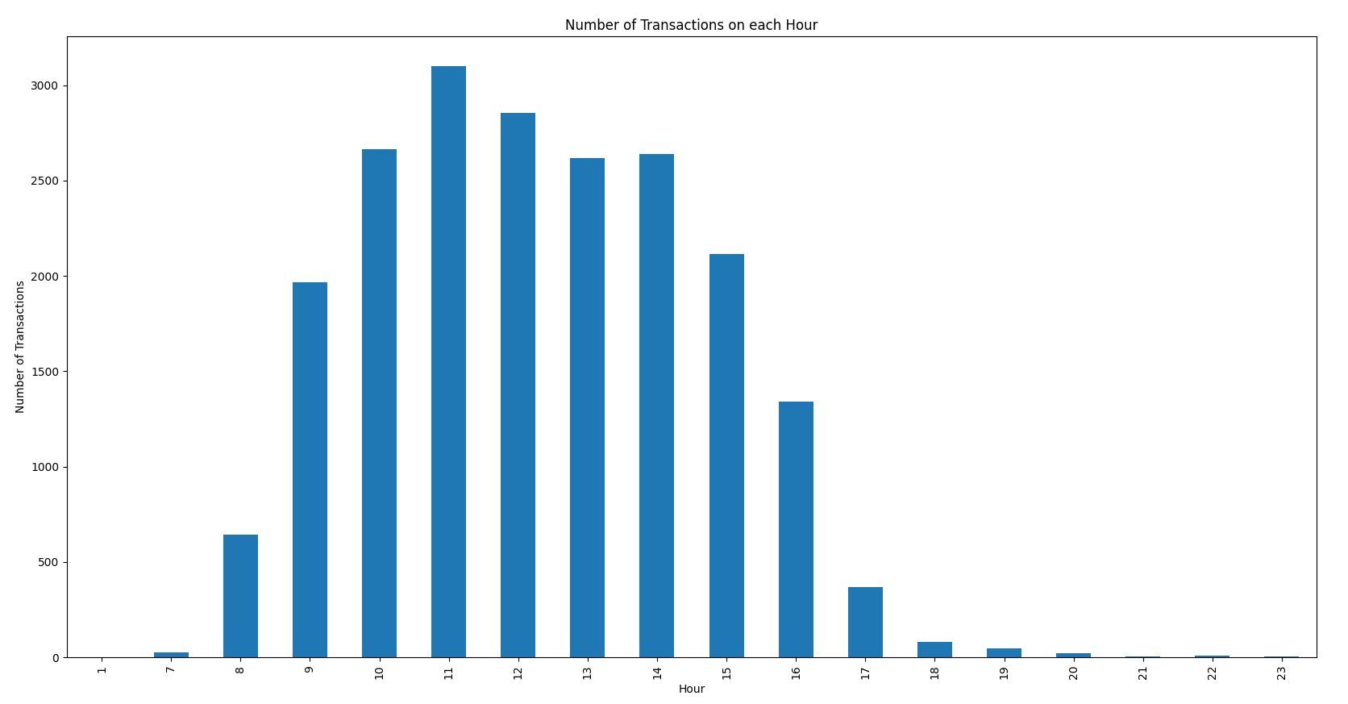
Data Mining Hourly Transactions
We want to find the bakery’s busiest time of day.
This can be used to tell them when they should start baking and how many things to back to have enough products satisfy the flow of customers.
Also helps in determining when shifts should start/end.

Slide 7
Data Mining Best-Selling Items
The Question we wanted to answer:
Which items are the best sellers within the bakery and how do these sales vary over different times such as day, week, month.
Can we identify any noticeable patterns in sales that could indicate time of day preferences for items.
Key Challenges:
Identifying best sellers using transaction counts.
Utilizing time and date segmentation to analyze sales patterns.

Slide 8
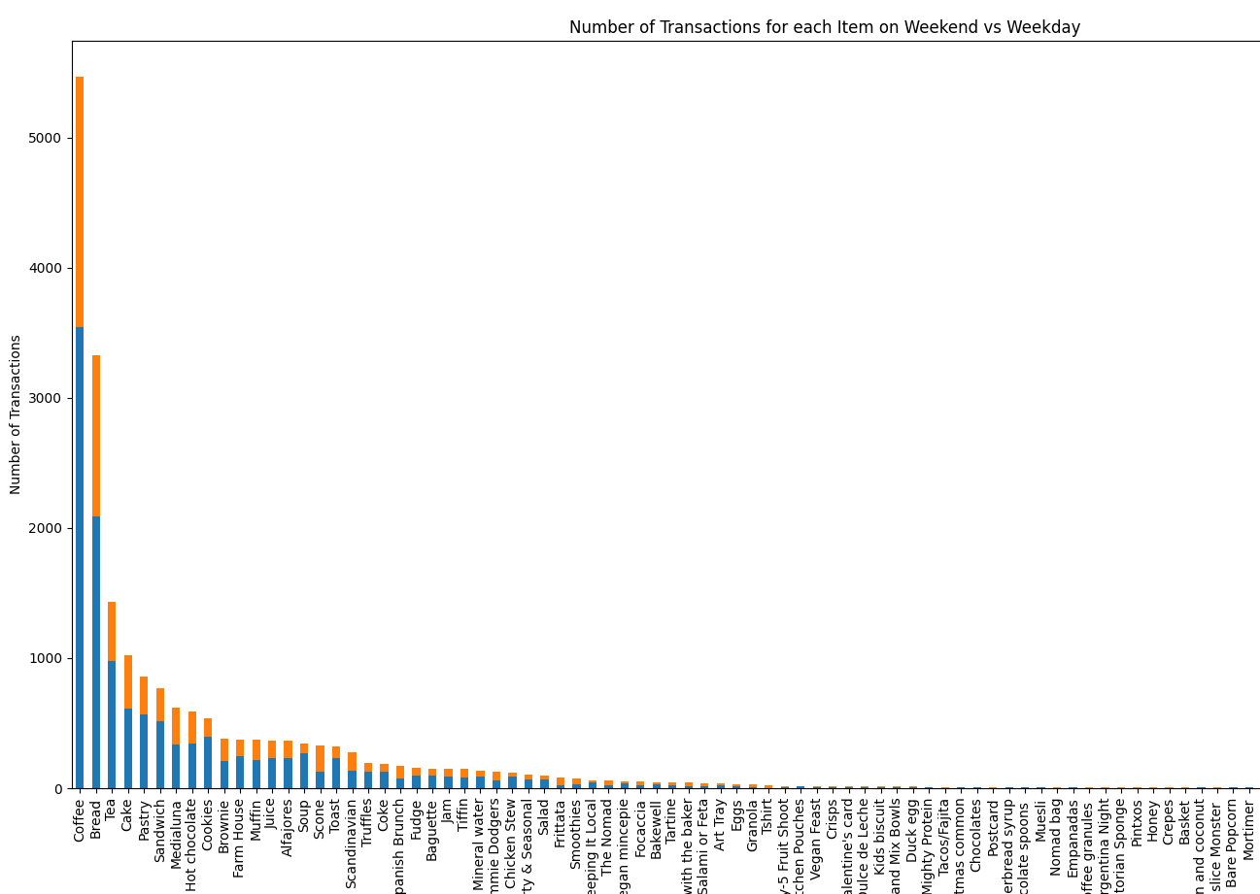

Data Mining Best-Selling Items
We aim to find which items sell the best from the bakery and when they tend to sell.
This data can be used to determine service times for certain items.
Can also help when to advertise certain products to draw in more customers
Analyze any seasonal items they plan on selling.

Slide 9
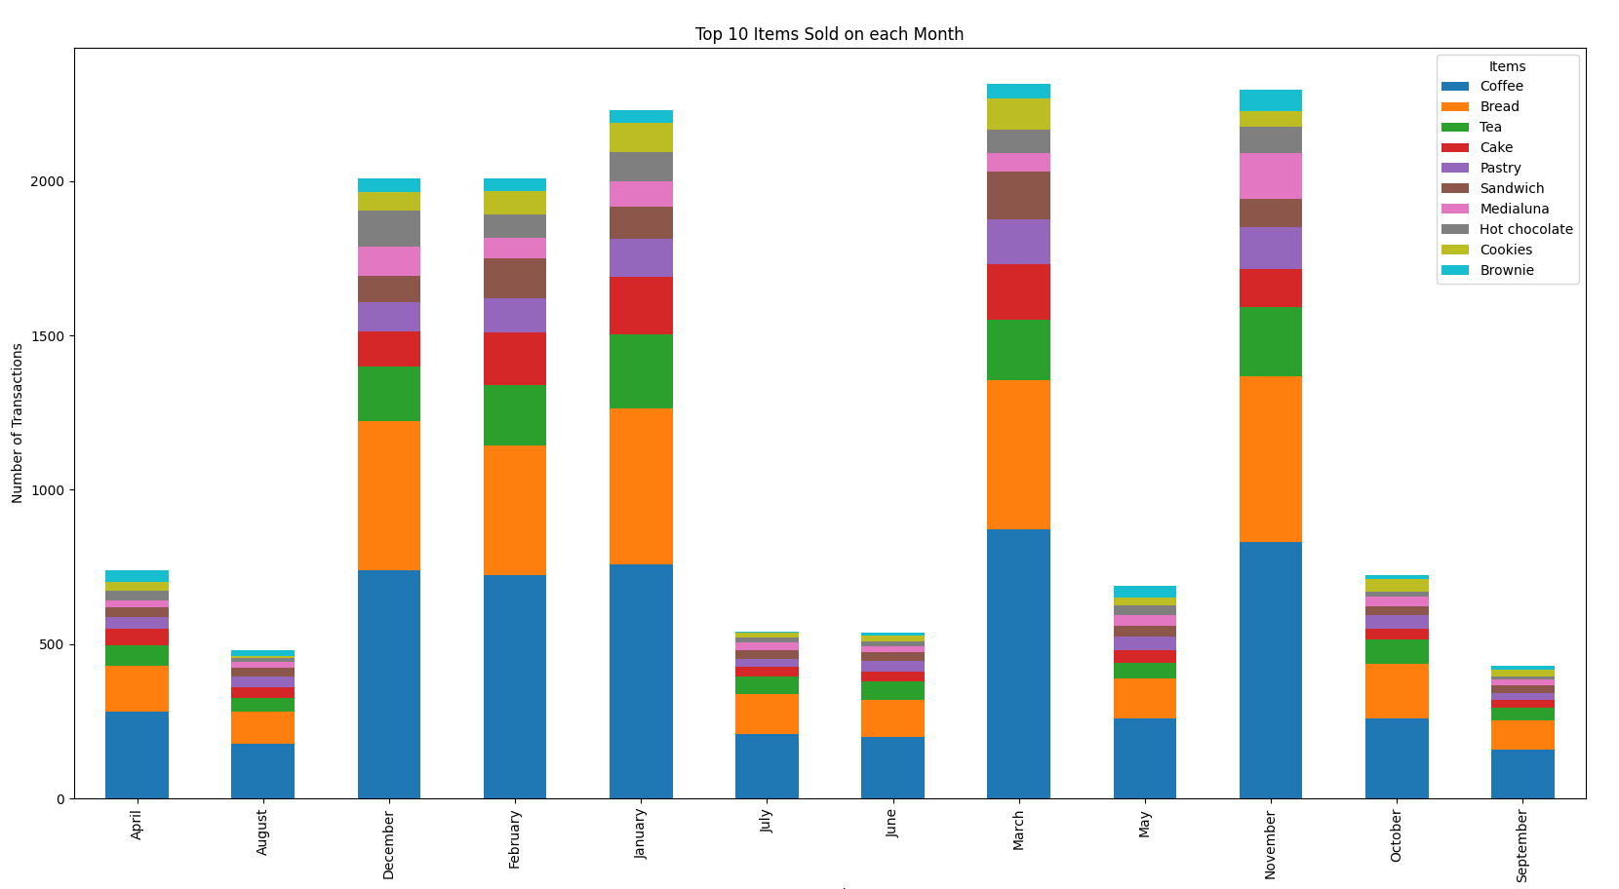
Best-Selling Items Example Output Graph

Slide 10
Datamining Frequent Item sets
The Question we wanted to answer:
How can we identify which bakery items are frequently purchased together?
Key Challenges:
Dealing with a large volume of data.
Pattern discovery so that we can determine the correct level of support and confidence.
Avoiding correlations that do not give any insight in relations to business decisions.

Slide 11
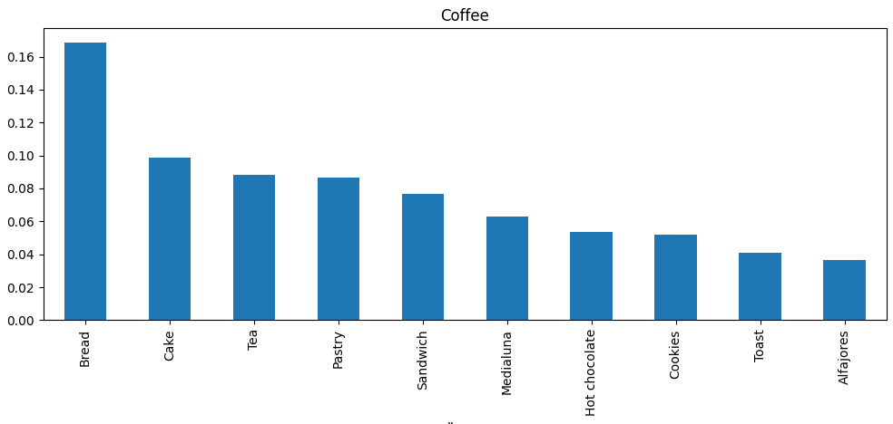
Frequent Item sets
We want to find what items are commonly purchased together.
This can be used to optimize the placement of items on menu’s or displays to entice customers to buy more items per transaction.

Slide 12
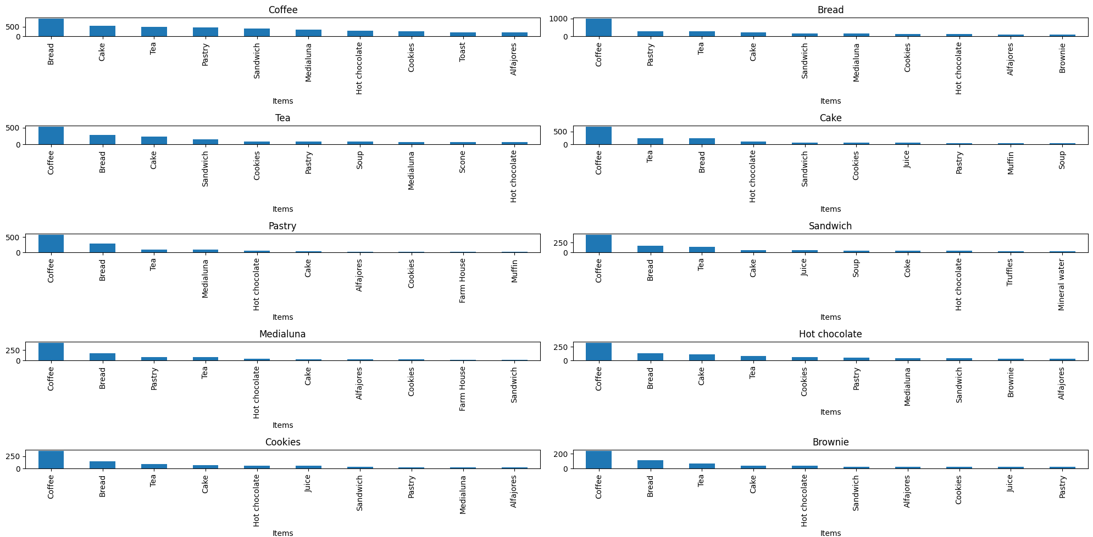
Frequent Item-Sets Example Output

Slide 13
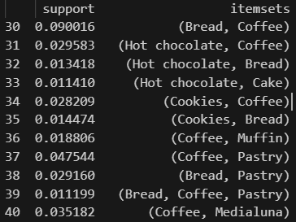
Frequent Item-Sets Example Output
We also analyze console output to gain a more detailed understanding of the interactions between these items.

